Slide 1
Fast Image Recovery Using Split Augmented Lagrangian Shrinkage Algorithm with Least Square QR
Presented by: Xin Yi
ECE 602: Introduction to Optimization-Winter 2020
Department of Electrical and Computer Engineering

Slide 2
Project Introduction
Image Recovery - a classical linear inverse problem.
Previous
(LSQR) iterative inversion
faster
SALSA
Proposed Solution
As shown in previous papers[2], it can save memory and significantly accelerate the computational time for Optoacoustic Tomography compared with the original one.
In this work, least square QR is applied to solve some more generalized image recovery problems, except for the reconstruction implemented in [2], I am also aiming to apply the improved method to other problems such as deblurring and inpainting, and compare with the previous algorithm results to see the improvements on speed.

Slide 3
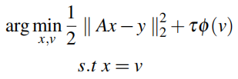
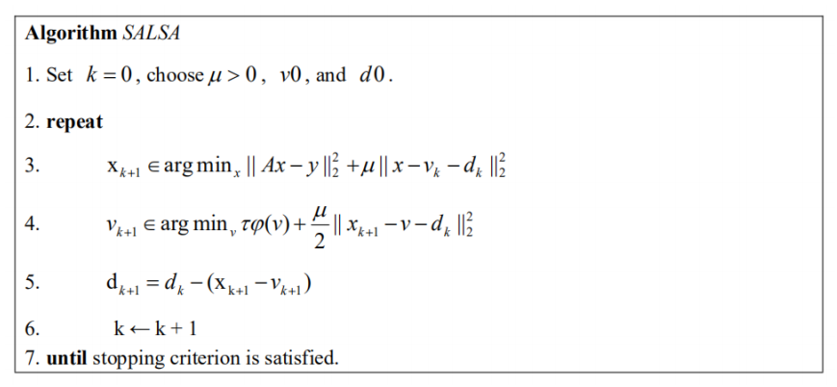
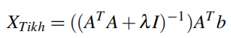
Existing solutions
Objective function :
(1)
(2)
Other solutions:
FISTA,
TwIST,
SpaRSA

Slide 4
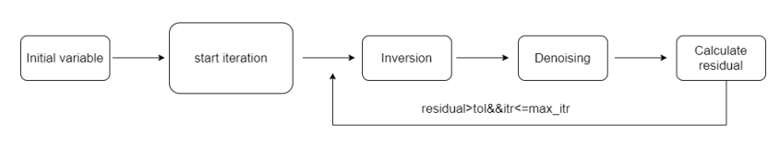
Proposed Solution
The objective function can be be iteratively solved by the sequence of sub- problems, in the main loop, firstly store x, v, u from previous iteration for psnr residual calculation and then do the inversion step to update the value of x, and then it goes to the denoising step, here the TV denoisier is used to update the value of v, together with updating the langrangian multiplier and parameter, finally calculate the residual to determine whether stop the iteration or not.

Slide 5
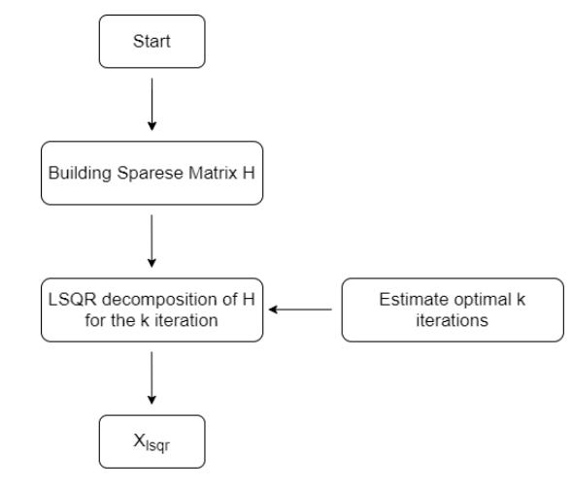
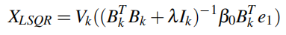
Proposed Solution
For the case k = n2, xLSQR = xTikh for a given value of λ, For all other cases, xLSQR becomes an approximation to xTikh.
In matlab, lsqr() solver is used to solve the system of linear equations equations A*x = b for x using the Least Squares Method.
(3)
[4]

Slide 6
Implementation
%i n v e r s i o n s t e p
G = @( z , t r a n s _ f l a g ) g f u n ( z , t r a n s _ f l a g , A, rho , dim ) ;
r h s = [ y ( : ) ; s q r t ( r h o ) ∗ x t i l d e ( : ) ] ;
[ x , ~ ] = l s q r (G, r h s , 1 ee3) ;
x = r e s h a p e ( x , dim ) ;
f u n c t i o n y = a f u n ( x , t r a n s p _ f l a g , h , dim )
- Image Deblurring Problem
i f st r cm p ( t r a n s p _ f l a g , ’transp ’ ) % y = A ’∗ x
x1 = x ( 1 :N) ;
x2 = x (N+ 1: 2∗N) ;
Atx = A( x1 , ’transp ’ ) ;
y = Atx + s q r t ( r h o ) ∗x2 ;
- Image Inpainting Problem
i f st r cm p ( t r a n s p _ f l a g , ’transp ’ ) % y = A ’∗ x
x = r e s h a p e ( x , [ rows , c o l s ] ) ;
y = x . ∗ mask ;
y = y ( : ) ;

Slide 7
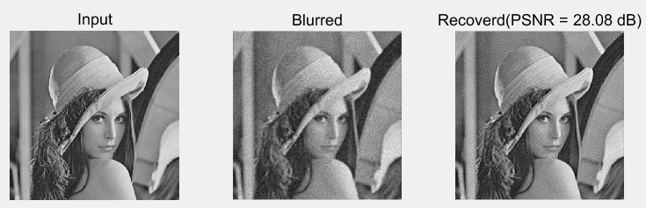
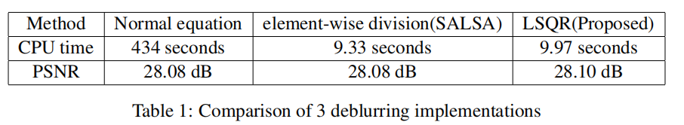
Experimental results
- Image Deblurring Problem

Slide 8
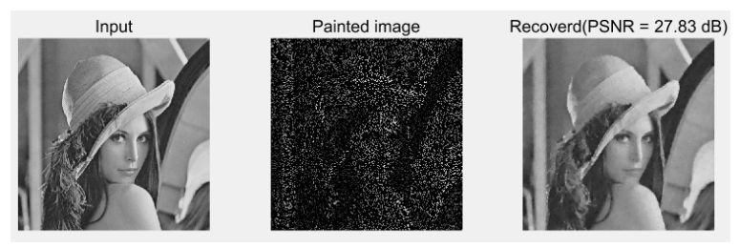
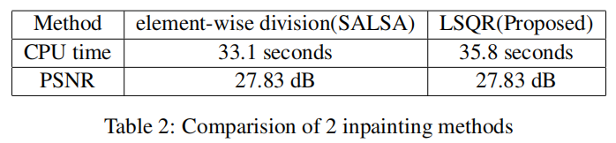
Experimental results
- Image Inpainting Problem

Slide 9
Conclusions
It is shown that solving the problem by LSQR can achieve better efficiency compared with using normal equation. However, there is no significant improvement compared with the original implementation SALSA algorithm.
It comes to a conclusion that the when inverse can already be computed very efficiently, there is no need to use LSQR since there is no significant acceleration, but proposed solution with LSQR works well in the problem where there is no feasible way to compute the inverse term with a explicit form matrix A.
Future works:
The proposed solution may also work well on the problems where the term in equation XTikh = ((ATA+λI)^-1)AT b is not invertibe. So in future works, it is worth trying to apply proposed solution or other similar approach to such problems to see if there would be improvement in terms of speed.

Slide 10
References
[1] Afonso, Manya V., José M. Bioucas-Dias, and Mário AT Figueiredo. "Fast image recovery using
variable splitting and constrained optimization." IEEE Transactions on Image Processing 19.9 (2010):
2345-2356.
[2] He, Hailong et al. “Optoacoustic Tomography Using Accelerated Sparse Recovery and
Coherence Factor Weighting.”Tomography (Ann Arbor, Mich.)vol. 2,2 (2016): 138-145.
doi:10.18383/j.tom.2016.00148.
[3] Ahmad, Rizwan, et al. "Plug and play methods for magnetic resonance imaging." arXiv preprint
arXiv:1903.08616 (2019).
[4] Prakash, Jaya, et al. "Basis pursuit deconvolution for improving model-based reconstructed images in
photoacoustic tomography." Biomedical optics express 5.5 (2014): 1363-1377.

